Slide 1
Backpropagation Algorithm
CSCI 601 471/671
NLP: Self-Supervised Models
https://self-supervised.cs.jhu.edu/sp2023/
[Slide credit: Andrej Karpathy and many others ]

Slide 2
HW update
HW1 grades are up!
Stats: Mean: 93.1 (std: ~5)
There was a mistake in grading Q4.6, but should be corrected now.
Regrade requests can be submitted via Gradescope.
Please don’t spam us! 🙏
HW3 is up!
Focus: training neural networks

Slide 3
Recap: Feel Forward Neural Networks
[Slide: HKUST]

Slide 4
Recap: Feel Forward Neural Networks
Weights to learn!
Weights to learn!
Weights to learn!
[Slide: HKUST]

Slide 5
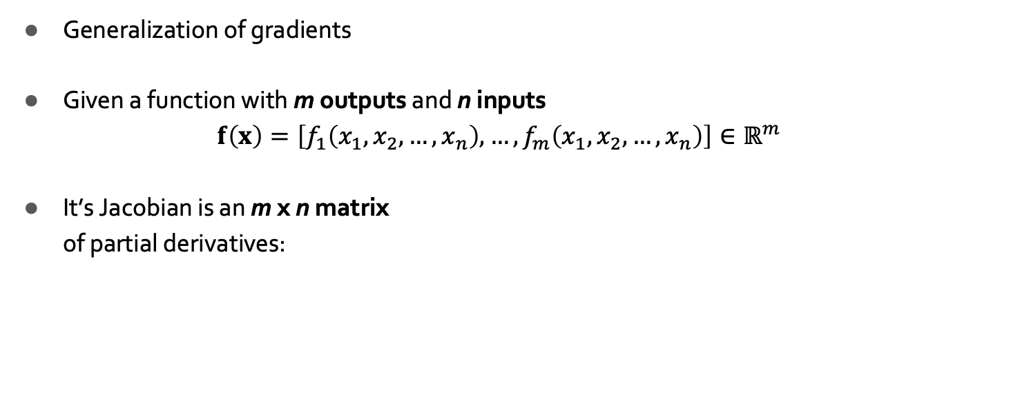
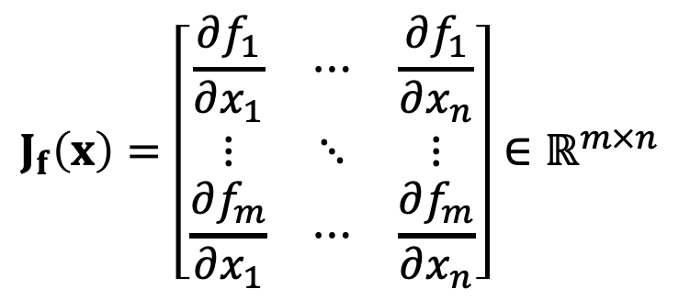
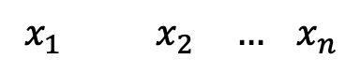
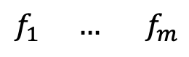
Recap: Jacobian Matrix
$$f_{1} {… f}_{m}$$
Generalization of gradients
Given a function with m outputs and n inputs
$$f\left(x\right)=\left[f_{1}\left(x_{1},x_{2}, …,x_{n}\right), …,f_{m}\left(x_{1},x_{2}, …,x_{n}\right)\right]∈ℝ^{m}$$
It’s Jacobian is an m x n matrix of partial derivatives:
$$x_{1} x_{2} … x_{n}$$
$$J_{f}\left(x\right)=\left[\begin{matrix}\frac{∂f_{1}}{∂x_{1}} & ⋯ & \frac{∂f_{1}}{∂x_{n}} \\ ⋮ & ⋱ & ⋮ \\ \frac{∂f_{m}}{∂x_{1}} & ⋯ & \frac{∂f_{m}}{∂x_{n}}\end{matrix}\right]∈ℝ^{m×n}$$

Slide 6
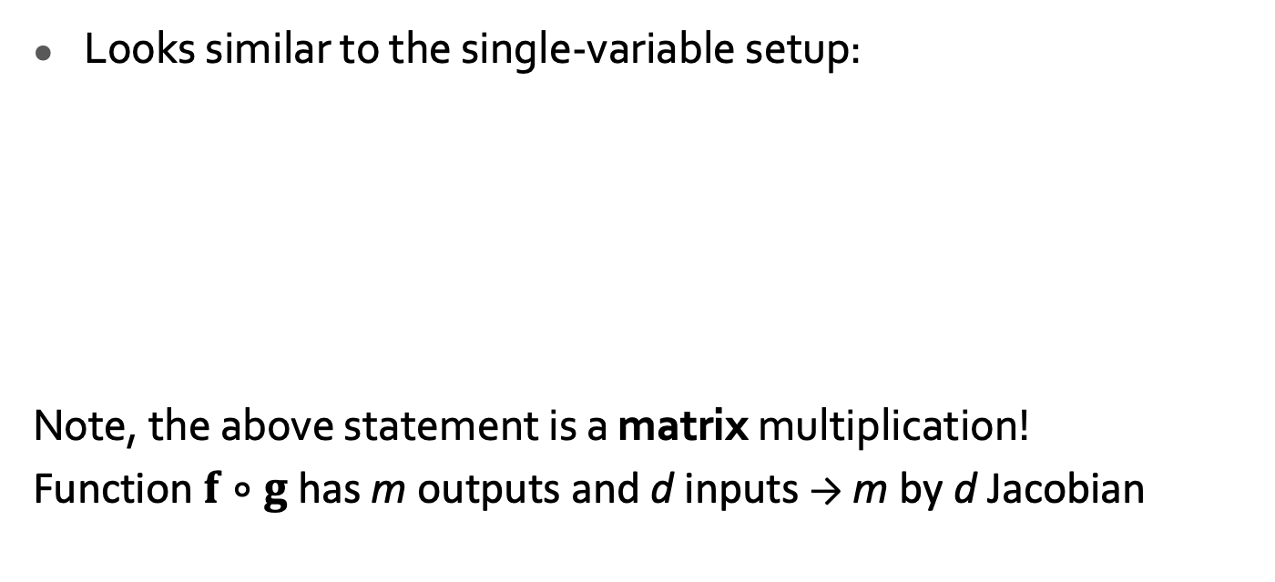
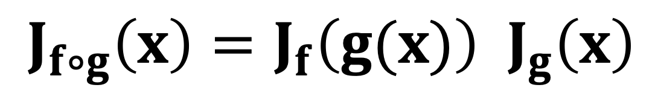



Recap: Chain Rule for Multivariable Functions
$$f$$
$$g$$
Looks similar to the single-variable setup:
Note, the above statement is a matrix multiplication!
Function $f∘g$ has m outputs and d inputs → m by d Jacobian
$$x$$
$$J_{f∘g}\left(x\right)=J_{f}\left(g(x)\right){ J}_{g}\left(x\right)$$

Slide 7

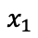
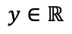
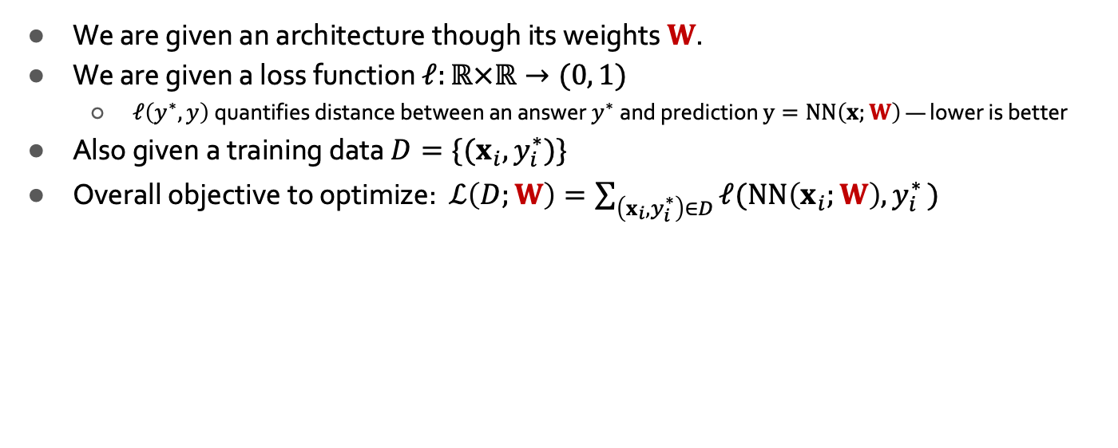
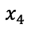
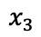
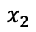
Training Neural Networks: Setup
We are given an architecture though its weights $W$.
We are given a loss function $ℓ:ℝ×ℝ→(0, 1)$
$ℓ\left(y^{∗}, y\right)$quantifies distance between an answer $y^{∗}$and prediction $y=NN\left(x;W\right)$ — lower is better
Also given a training data $D=\{(x_{i}, y_{i}^{∗})\}$
Overall objective to optimize: $ℒ\left(D;W\right)=\sum_{\left(x_{i}, y_{i}^{∗}\right)∈D}{ℓ(NN\left(x_{i};W\right){, y}_{i}^{∗})}$
$$x_{1}$$
$$x_{2}$$
$$x=\left(x_{1},x_{2},x_{3},x_{4}\right)∈ℝ^{4}$$
Weights to learn!
Weights to learn!
Weights to learn!
$$y∈ℝ$$
$$x_{3}$$
$$x_{4}$$

Slide 8
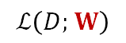
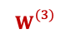
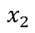
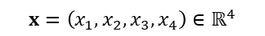

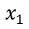
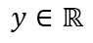
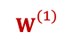
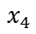
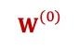
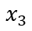

Training Neural Networks ~ Optimizing Parameters
We can use gradient descent to minimizes the loss.
At each step, the weight vector is modified in the direction that produces the steepest descent along the error surface.
$$ℒ\left(D;W\right)$$
$$W$$
$$W_{}^{(3)}$$
$$W_{}^{(2)}$$
$$W_{}^{(1)}$$
$$W_{}^{(0)}$$
$$x_{1}$$
$$x_{2}$$
$$x=\left(x_{1},x_{2},x_{3},x_{4}\right)∈ℝ^{4}$$
Weights to learn!
Weights to learn!
Weights to learn!
$$y∈ℝ$$
$$x_{3}$$
$$x_{4}$$

Slide 9
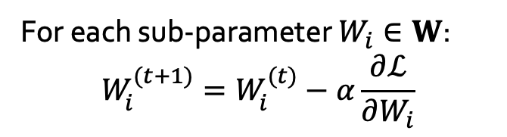

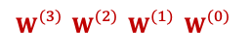

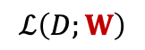
Training Neural Networks ~ Optimizing Parameters
It all comes down to effectively computing $\frac{∂ℒ}{∂W_{i}}$
For each sub-parameter $W_{i}∈W$:
$$W_{i}^{(t+1)}=W_{i}^{(t)}−α\frac{∂ℒ}{∂W_{i}}$$
$$ℒ\left(D;W\right)$$
$$W$$
$W_{}^{(3)}$ $W_{}^{(2)}$ $W_{}^{(1)}$ $W_{}^{(0)}$
$$x_{1}$$
$$x_{2}$$
$$x=\left(x_{1},x_{2},x_{3},x_{4}\right)∈ℝ^{4}$$
Weights to learn!
Weights to learn!
Weights to learn!
$$y∈ℝ$$
$$x_{3}$$
$$x_{4}$$

Slide 10
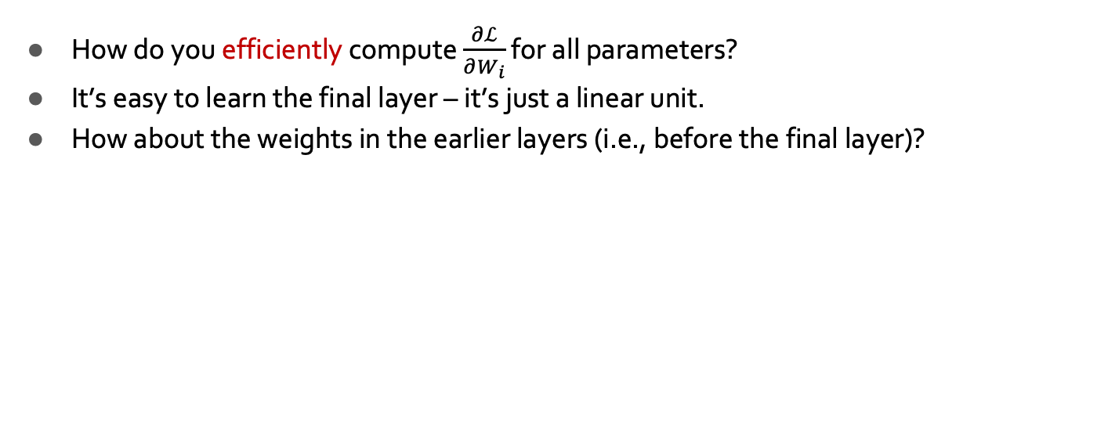
Training Neural Networks ~ Computing the Gradients
How do you efficiently compute $\frac{∂ℒ}{∂W_{i}}$ for all parameters?
It’s easy to learn the final layer – it’s just a linear unit.
How about the weights in the earlier layers (i.e., before the final layer)?
$$x_{1}$$
$$x_{2}$$
$$x=\left(x_{1},x_{2},x_{3},x_{4}\right)∈ℝ^{4}$$
Weights to learn!
Weights to learn!
Weights to learn!
$$y∈ℝ$$
$$x_{3}$$
$$x_{4}$$

Slide 11
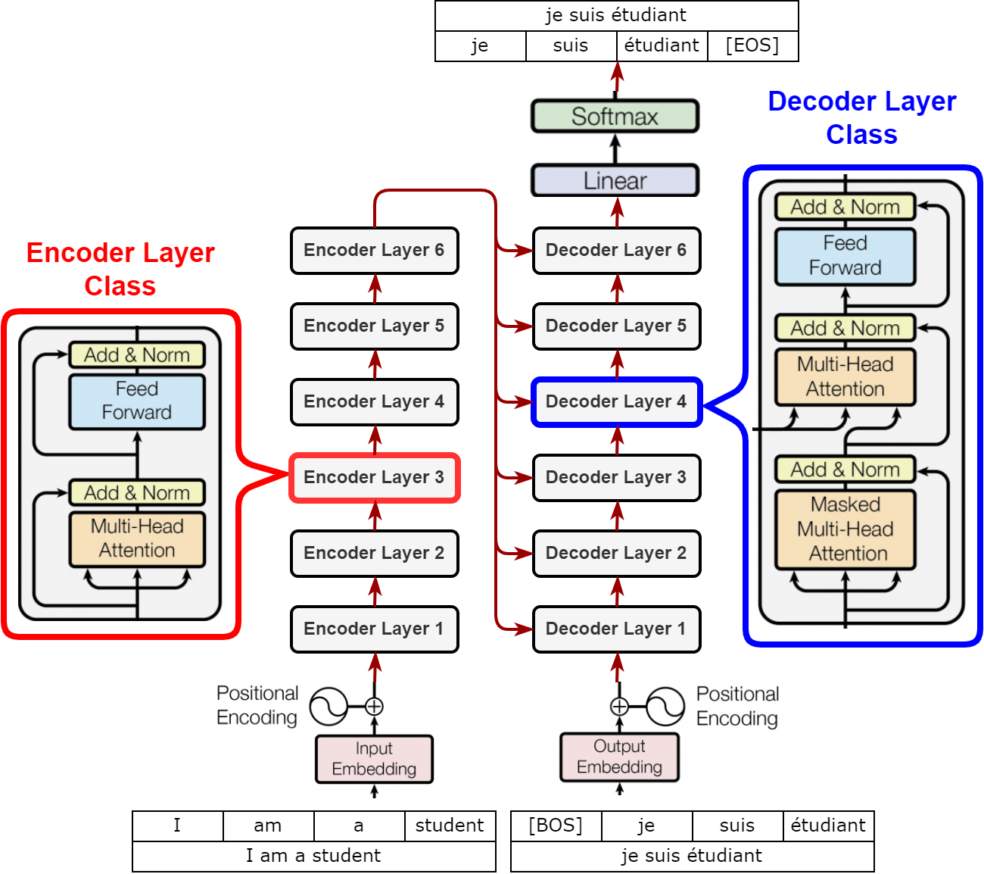
Necessity of a Principled Algorithm for Gradient Computation
Depth gives more representational capacity to neural networks.
However, training deep nets is not trivial.
Even if we have analytical formula for each gradient, they can be tedious and must be repeated for each new architecture.
The solution is “Backpropagation” algorithm!
Architecture of the BERT model with over 24 layers and millions of parameters — we will study get to this model in a few weeks!

Slide 12
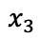
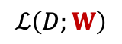
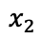
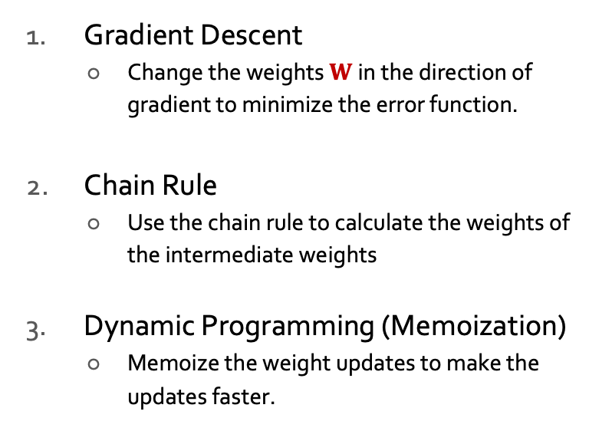
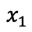
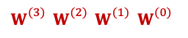

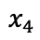
Key Intuitions Required for BP
$$ℒ\left(D;W\right)$$
Gradient Descent
Change the weights $W$in the direction of gradient to minimize the error function.
Chain Rule
Use the chain rule to calculate the weights of the intermediate weights
Dynamic Programming (Memoization)
Memoize the weight updates to make the updates faster.
$$W$$
$W_{}^{(3)}$ $W_{}^{(2)}$ $W_{}^{(1)}$ $W_{}^{(0)}$
$$x_{1}$$
$$x_{2}$$
$$x_{3}$$
$$x_{4}$$

Slide 13
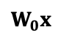
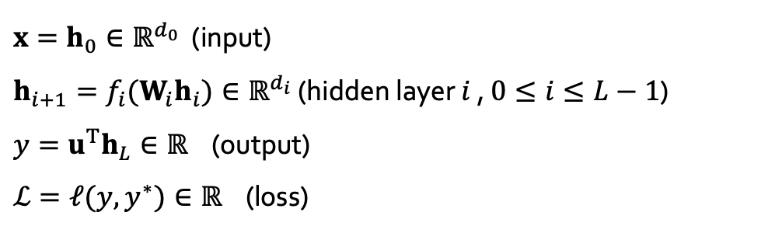
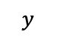
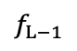
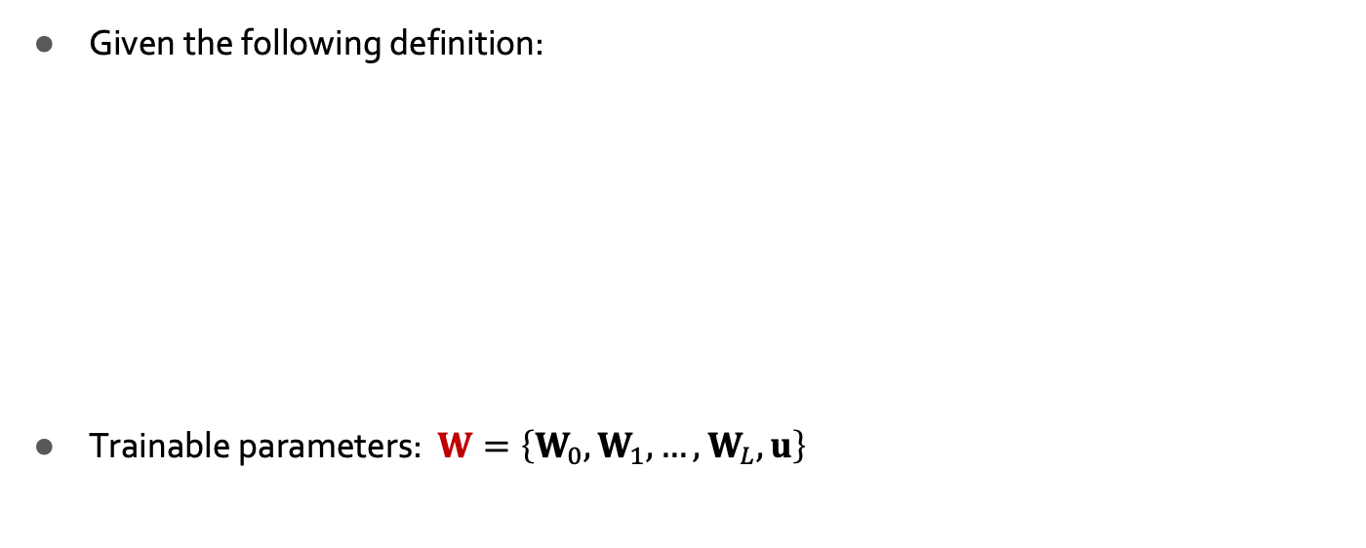
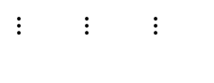
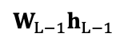
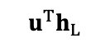
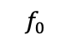

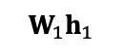
A Generic Neural Network
$$y$$
$$u^{T}h_{L}$$
+
Given the following definition:
Trainable parameters: $W=\left\{W_{0},W_{1}, …,W_{L}, u\right\}$
$$f_{L−1}$$
$x=h_{0}∈ℝ^{d_{0}}$ (input)
$h_{i+1}=f_{i}(W_{i}h_{i})∈ℝ^{d_{i}}$ (hidden layer $i$ , $0≤i≤L−1$)
$y=u^{T}h_{L}∈ℝ$ (output)
$ℒ=ℓ(y,y^{∗})∈ℝ$ (loss)
$$W_{L−1}h_{L−1}$$
$⋮ ⋮$ $⋮$
$$W_{1}h_{1}$$
$$f_{0}$$
$$W_{0}x$$
$$x$$

Slide 14
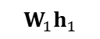

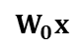
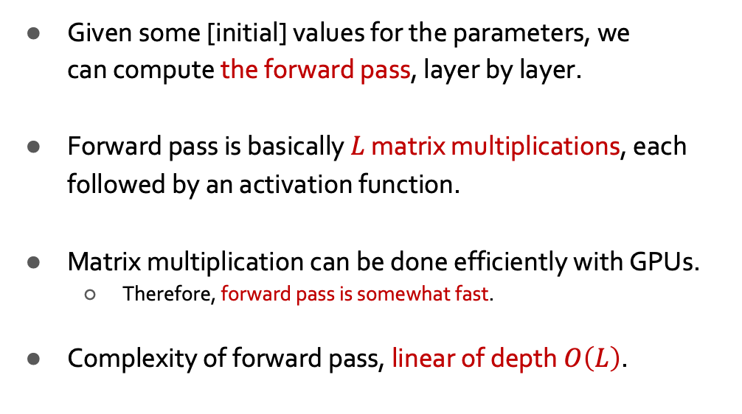
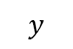
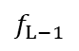
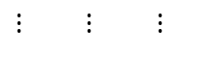



A Generic Neural Network: Forward Step
$$y$$
$$u^{T}h_{L}$$
+
Given some [initial] values for the parameters, we can compute the forward pass, layer by layer.
Forward pass is basically $L$ matrix multiplications, each followed by an activation function.
Matrix multiplication can be done efficiently with GPUs.
Therefore, forward pass is somewhat fast.
Complexity of forward pass, linear of depth $O\left(L\right)$.
$$f_{L−1}$$
$$W_{L−1}h_{L−1}$$
$⋮ ⋮$ $⋮$
$$W_{1}h_{1}$$
$$f_{0}$$
$$W_{0}x$$
$$x$$

Slide 15




A Generic Neural Network: Direct Gradients
$$y$$
$$u^{T}h_{L}$$
+
$x=h_{0}∈ℝ^{d_{0}}$ (input)
$h_{i+1}=f_{i}(W_{i}h_{i})∈ℝ^{d_{i}}$ ($0≤i≤L−1$)
$y=u^{T}h_{L}∈ℝ$ (output)
$ℒ=ℓ(y,y^{∗})∈ℝ$ (loss)
$$W=\left\{W_{0},W_{1}, …,W_{L}, u\right\}$$
$$f_{L−1}$$
$$W_{L−1}h_{L−1}$$
We want the gradients of $ℒ$ with respect to model parameters.
$∇_{ℒ}\left(W_{L−1}\right)={\left(J_{ℒ}\left(W_{L−1}\right)\right)}^{T}={\left(J_{ℓ}\left(y\right){ J}_{y}\left(h_{L}\right){ J}_{h_{L}}\left(W_{L−1}\right)\right)}^{T}$
$∇_{ℒ}\left(W_{L−2}\right)={\left(J_{ℒ}\left(W_{L−2}\right)\right)}^{T}={\left(J_{ℓ}\left(y\right){ J}_{y}\left(h_{L}\right){ J}_{h_{L}}\left(h_{L−1}\right){ J}_{h_{L−1}}\left(W_{L−2}\right)\right)}^{T}$
…
$∇_{ℒ}\left(W_{0}\right)={\left(J_{ℒ}\left(W_{L−3}\right)\right)}^{T}={\left(J_{ℓ}\left(y\right){ J}_{y}\left(h_{L}\right){ J}_{h_{L}}\left(h_{L−1}\right)…J_{h_{1}}\left(W_{0}\right)\right)}^{T}$
In total, how many matrix multiplications are done here?
(A) $O\left(L\right)$ (B) $O\left(L^{2}\right)$ (C) $O\left(L^{3}\right)$ (C) $O\left(exp(L)\right)$
$⋮ ⋮$ $⋮$
3 matrix
multiplications
4 matrix
multiplications
$L+2$ matrix
multiplications
Can we do better than this? 🤔
$$x$$

Slide 16





A Generic Neural Network: Gradients with Caching/Memoization
$$y$$
$$u^{T}h_{L}$$
+
$$∇_{ℒ}\left(W_{L−1}\right)={\left(J_{ℓ}\left(y\right){ J}_{y}\left(h_{L}\right){ J}_{h_{L}}\left(W_{L−1}\right)\right)}^{T}$$
$$∇_{ℒ}\left(W_{L−2}\right)={\left(J_{ℓ}\left(y\right){ J}_{y}\left(h_{L}\right){ J}_{h_{L}}\left(h_{L−1}\right){ J}_{h_{L−1}}\left(W_{L−2}\right)\right)}^{T}$$
…
$$∇_{ℒ}\left(W_{0}\right)={\left(J_{ℓ}\left(y\right){ J}_{y}\left(h_{L}\right){ J}_{h_{L}}\left(h_{L−1}\right)…J_{h_{1}}\left(W_{0}\right)\right)}^{T}$$
$$={\left(δ_{L}{ J}_{h_{L}}\left(W_{L−1}\right)\right)}^{T}$$
Parameter gradients depend on the gradients of the earlier layers!
So, when computing gradients at each layer, we don’t need to start from scratch!
I can reuse gradients computed for higher layers for lower layers (i.e., memoization).
In total, how many matrix multiplications are done here when using caching/memoization?
(A) $O\left(L\right)$ (B) $O\left(L^{2}\right)$ (C) $O\left(L^{3}\right)$ (C) $O\left(exp(L)\right)$
$$f_{L−1}$$
$$={\left(δ_{L−1}{ J}_{h_{L−1}}\left(W_{L−2}\right)\right)}^{T}$$
$$W_{L−1}h_{L−1}$$
$$={\left(δ_{1}{ J}_{h_{1}}\left(W_{0}\right)\right)}^{T}$$
$⋮ ⋮$ $⋮$
Let $δ_{i}$ denote Jacobian at the output of layer $i$:
$$δ_{i}=J_{ℓ}\left(y\right){ J}_{y}\left(h_{L}\right){ J}_{h_{L}}\left(h_{L−1}\right)…{ J}_{h_{i}}\left(h_{i−1}\right)$$
$δ_{i}=$ $δ_{i+1}$ ${ J}_{h_{i}}\left(h_{i−1}\right)$
$$x$$

Slide 17

A Generic Neural Network: Backward Step
$$y$$
$$u^{T}h_{L}$$
+
Backward step computes the gradients starting from the end to the beginning, layer by layer.
Start by computing local gradients: ${ J}_{h_{i}}\left(h_{i−1}\right)$
Use then to compute upstream gradients $δ_{L}$, then $δ_{L−1}$, then $δ_{L−2}$, ….
Use these to compute global gradients:$∇_{ℒ}\left(W_{i}\right)$
Computational cost as a function of depth:
With memoization, gradient computation is a linear function of depth $L$
(same cost as the forward process!!)
Without memorization, gradients computation would grow quadratic with $L$
$$f_{L−1}$$
$$W_{L−1}h_{L−1}$$
$⋮ ⋮$ $⋮$
$$W_{1}h_{1}$$
$$f_{0}$$
$$W_{0}x$$
$$x$$

Slide 18

A Generic Neural Network: Back Propagation
$$y$$
$$u^{T}h_{L}$$
+
Initialize network parameters with random values
Loop until convergence
Loop over training instances
Forward step: Start from the input and compute all the layers till the end (loss $ℒ$)
Backward step: Compute local gradients, starting from the last layer Compute upstream gradients $δ_{i}$ values, starting from the last layer Use $δ_{i}$ values to compute global gradients $∇_{ℒ}\left(W_{i}\right)$ at each layer
Gradient update: Update each parameter: $W_{i}^{(t+1)}←W_{i}^{(t)}−α$ $∇_{ℒ}\left(W_{i}\right)$
$$f_{L−1}$$
In practice, this step is done over batches of instances!
$$W_{L−1}h_{L−1}$$
$⋮ ⋮$ $⋮$
$$W_{1}h_{1}$$
$$f_{0}$$
$$W_{0}x$$
$$x$$

Slide 19

Computation Graph: Example
In reality, networks are not as regular as the previous example …

Slide 20






Back-Prop in General Computation Graph
Single scalar output
What if the network does not have a regular structure? Same idea!
Sort the nodes in topological order (what depends on what)
Forward-Propagation:
Visit nodes in topological sort order and compute value of node given predecessors
Backward-Propagation:
Compute local gradients
Visit nodes in reverse order and compute global gradients using gradients of successors
…
…
Inputs

Slide 21


Computation Graph: An Example
Evaluated at: x = -2, y = 5, z = -4
[Slide: Stanford CS231N]

Slide 22

Computation Graph: An Example
Evaluated at: x = -2, y = 5, z = -4
Want:
[Slide: Stanford CS231N]

Slide 23
Computation Graph: An Example
Evaluated at: x = -2, y = 5, z = -4
Start with local gradients!
[Slide: Stanford CS231N]

Slide 24




Computation Graph: An Example
Evaluated at: x = -2, y = 5, z = -4
Start with local gradients!
[Slide: Stanford CS231N]

Slide 25

Computation Graph: An Example
Evaluated at: x = -2, y = 5, z = -4
Start with local gradients!
[Slide: Stanford CS231N]

Slide 26
Computation Graph: An Example
Evaluated at: x = -2, y = 5, z = -4
Start with local gradients!
[Slide: Stanford CS231N]

Slide 27

Computation Graph: An Example
Evaluated at: x = -2, y = 5, z = -4
Start with local gradients!
[Slide: Stanford CS231N]

Slide 28
Computation Graph: An Example
Evaluated at: x = -2, y = 5, z = -4
Start with local gradients!
[Slide: Stanford CS231N]

Slide 29

Computation Graph: An Example
Evaluated at: x = -2, y = 5, z = -4
Start with local gradients!
[Slide: Stanford CS231N]

Slide 30


Computation Graph: An Example
Evaluated at: x = -2, y = 5, z = -4
Start with local gradients!
Chain rule:
Upstream gradient
Local gradient
[Slide: Stanford CS231N]

Slide 31
Computation Graph: An Example
Evaluated at: x = -2, y = 5, z = -4
Start with local gradients!
Chain rule:
Upstream gradient
Local gradient
[Slide: Stanford CS231N]

Slide 32

Computation Graph: An Example
Evaluated at: x = -2, y = 5, z = -4
Start with local gradients!
[Slide: Stanford CS231N]

Slide 33
Computation Graph: An Example
Evaluated at: x = -2, y = 5, z = -4
Start with local gradients!
Chain rule:
Upstream gradient
Local gradient
[Slide: Stanford CS231N]

Slide 34
Computation Graph: An Example
Evaluated at: x = -2, y = 5, z = -4
Start with local gradients!
Chain rule:
Upstream gradient
Local gradient
[Slide: Stanford CS231N]

Slide 35
A Generic Example
Figure from Andrej Karpathy

Slide 36


f
Figure from Andrej Karpathy

Slide 37


“local gradient”
f
Figure from Andrej Karpathy

Slide 38

“local gradient”
f
“Upstream
gradient”
Figure from Andrej Karpathy

Slide 39

“local gradient”
f
“Downstream gradients”
“Upstream
gradient”
Figure from Andrej Karpathy

Slide 40

“local gradient”
f
“Downstream gradients”
“Upstream
gradient”
Figure from Andrej Karpathy

Slide 41
“local gradient”
f
“Downstream gradients”
“Upstream
gradient”
Figure from Andrej Karpathy

Slide 42
Demo time!
Link: https://playground.tensorflow.org/

Slide 43
Chapter Plan
Feed-forward networks
Neural nets: brief history
Word2Vec as a simple neural network
Training neural networks: back-propagation
Backprop in practice

Slide 44
Backprop in PyTorch
Want:
x = torch.tensor(-2.0, requires_grad=True)
y = torch.tensor(5.0, requires_grad=True)
z = torch.tensor(-4.0, requires_grad=True)
f = (x+y)*z # Define the computation graph
f.backward() # PyTorch’s internal backward gradient computation print('Gradients after backpropagation:', x.grad, y.grad, z.grad)

Slide 45


PyTorch’s Implementation: Forward/Backward API
PyTorch has implementation of forward/backward operations for various operators.
Example: multiplication operator

Slide 46


PyTorch Operators
PyTorch’s lower-level functions translate activities to graphics processor via libraries like OpenGL

Slide 47


Example Activation Functions

Slide 48
Why Learn All These Details About Backprop?
Modern deep learning frameworks compute gradients for you!
But why take a class on compilers or systems when they are implemented for you?
Understanding what is going on under the hood is useful!
Backpropagation doesn’t always work perfectly out of the box
Understanding why is crucial for debugging and improving models

Slide 49
Backprop in Practice

Slide 50

Activation Functions
How do you choose what activation function to use?
In general, it is problem-specific and might require trial-and-error.
Here are some tips about popular action functions.

Slide 51








Activation Functions : Sigmoid
Squashes numbers to range [0,1]
Historically popular, interpretation as “firing rate” of a neuron
Key limitation: Saturated neurons “kill” the gradients
Whenever |x| > 5, the gradients are basically zero.
If all the gradients flowing back will be zero and weights will never change.
x
sigmoid
gate
[dance figure: https://www.imaginary.org/gallery/maths-dance-moves]

Slide 52

Activation Functions : Tanh
Symmetric around [-1, 1]
Still saturates |x| > 3 and “kill” the gradients
Zero-centered — good for stacking hidden layers
[LeCun et al., 1991]
[dance figure: https://www.imaginary.org/gallery/maths-dance-moves]

Slide 53


Activation Functions : ReLU
Computationally efficient
In practice, converges faster than sigmoid/tanh in practice
Does not saturate (in +region) — will die less!
ReLU
(Rectified Linear Unit)
[Krizhevsky et al., 2012]
[dance figure: https://www.imaginary.org/gallery/maths-dance-moves]

Slide 54




Activation Functions : Leaky ReLU
Does not saturate — will not die.
Computationally efficient
In practice it converges faster than sigmoid/tanh in practice
Other parametrized variants:
Parametric Rectifier (PReLU):
Maxout:
Provide more flexibility, though at the cost of more learnable parameters.
For example, Maxout doubles the number of parameters.
[He et al., 2015]
[Goodfellow et al., 2013]
[dance figure: https://www.imaginary.org/gallery/maths-dance-moves]

Slide 55
How do You Choose What Activation Function to Use?
In general, it is problem-specific and might require trial-and-error.
A useful recipe:
Generally, ReLU is a good activation to start with.
Time/compute permitting, you can try other activations to squeeze out more performance.

Slide 56
Layer and batch normalization
TODO

Slide 57

Exploding/Vanishing Gradients
$$y$$
$$u^{T}h_{L}$$
+
Remember gradient computation at layer $L−k$:
This matrix multiplication could quickly approach
$∞,$if the matrix elements are a large — exploding gradients.
$0$, if the matrix elements are small — vanishing gradients.
For those interested, convergences of matrix powers is determined by its largest eigenvalue (out of scope for this class, extra credit).
$∞/0$ gradients would kill learning (no flow of information).
$$f_{L−1}$$
$$∇_{ℒ}\left(W_{L−k}\right)={\left(J_{ℓ}\left(y\right){ J}_{y}\left(h_{L}\right){ J}_{h_{L}}\left(h_{L−1}\right){ J}_{h_{L−1}}\left(W_{L−2}\right)…{ J}_{h_{L−k+1}}\left(W_{L−k}\right)\right)}^{T}$$
$$W_{L−1}h_{L−1}$$
O(k)-many matrix multiplication
$⋮ ⋮$ $⋮$
$$W_{1}h_{1}$$
$$f_{0}$$
$$W_{0}x$$
$$x$$

Slide 58


Residual Connections/Blocks
Create direct “information highways” between layers.
Shown to diminish the effect of vanishing/exploding gradients
Early in the training, there are fewer layers to propagate through.
The network would restore the skipped layers, as it learns richer features.
It is also shown to make the optimization objective smoother.
Fun fact: the paper introducing residual layers (He et al. 2015) is the most cited paper of century.
[Li et al. “Visualizing the Loss Landscape of Neural Nets”]

Slide 59
Ideas:
Have a pytorch example: training neural net in 20 lines
Homework:
flat backprop
Gadient check
automatic backprop

Slide 60
Batching
Somewhere talk about why batching instances is important.
Another place also define: epoch vs step

Slide 61


Slide 62
TODO: discuss “symmetry breaking” in the context of weight initialization

Slide 63

Manual Gradient checking: Numeric Gradient
For small h (≈ 1e-4),
Easy to implement correctly
But approximate and very slow:
You have to recompute f for every parameter of our model
Useful for checking your implementation
In the old days, we hand-wrote everything, doing this everywhere was the key test
Now much less needed; you can use it to check layers are correctly implemented

Slide 64
Weight Initialization
Initializing all weights with a fixed constant (e.g., 0) is a very bad idea! (why?)
If the neurons start with the same weights, then all the neurons will follow the same gradient, and will always end up doing the same thing as one another.

Slide 65
Weight Initialization
Better idea: initialize weights with random Gaussian noise.
There are fancier initializations (Xavier, Kaiming, etc.) that we won’t get into.
x = torch.tensor.empty(3, 5)
nn.init.normal_(w)
[read more here: https://pytorch.org/docs/stable/nn.init.html]

Slide 66
Comments on Training
No guarantee of convergence; neural networks form non-convex functions with multiple local minima
In practice, many large networks can be trained on large amounts of data for realistic problems.
May be hard to set learning rate and to select number of hidden units and layers.
Many steps (tens of thousands) may be needed for adequate training. Large data sets may require many hours of CPU
Termination criteria: Number of epochs; Increased error on a validation set.
To avoid local minima: several trials with different random initial weights with majority or voting techniques

Slide 67
Over-training Prevention
Running too many epochs and/or a NN with many hidden layers may lead to an overfit network
Keep a held-out validation set and evaluate accuracy after every epoch
Early stopping: maintain weights for best performing network on the validation set and return it when performance decreases significantly beyond that.
To avoid losing training data to validation:
Use 10-fold cross-validation to determine the average number of epochs that optimizes validation performance
Train on the full data set using this many epochs to produce the final results

Slide 68
Over-fitting prevention
Too few hidden units prevent the system from adequately fitting the data and learning the concept.
Using too many hidden units leads to over-fitting.
Similar cross-validation method can be used to determine an appropriate number of hidden units. (general)
Another approach to prevent over-fitting is weight-decay: all weights are multiplied by some fraction in (0,1) after every epoch.
Encourages smaller weights and less complex hypothesis
Equivalently: change Error function to include a term for the sum of the squares of the weights in the network. (general)

Slide 69


Dropout training
In each forward pass, randomly set some neurons to zero
Probability of dropping is a hyperparameter; 0.5 is common
Dropout is implicitly a ensemble (average) of model that share parameters.
Each binary mask is one model
For example, an FC layer with 4096 units has 2⁴⁰⁹⁶ ~ 10¹²³³ possible masks!
Only ~ 10⁸² atoms in the universe ...
[Hinton et al, 2012; Srivastava et al, “Dropout: A simple way to prevent neural networks from overfitting”, JMLR 2014]

Slide 70





Dropout During Test Time
The issue for test time is that Dropout adds randomization.
Each dropout mask would lead to a slightly different outcome.
In ideal world, we would like to “average out” the outcome across all the possible random masks:
Not feasible.
The alternative is to not apply dropout. Without dropout, the input values to each neuron would be higher than what was seen during the training (mismatch between train/test).
Example: Input to activation during:
training time: $E\left[a\right]=\frac{1}{4}\left(w_{1}x_{1}+w_{2}x_{2}\right)+\frac{1}{4}\left(0+0\right)$ + $\frac{1}{4}\left(0+w_{2}x_{2}\right)$ + $\frac{1}{4}\left(w_{1}x_{1}+0\right)=\frac{1}{2}\left(w_{1}x_{1}+w_{2}x_{2}\right)$
test time: $E\left[a\right]=w_{1}x_{1}+w_{2}x_{2}$
Solution: scale the values proportional to dropout probability.
Can be applied in either testing (scaling down) or training (scaling up).
a
w₁
w₂
x
y

Slide 71
Dropout in Practice
dropout = nn.Dropout(p=0.2)
x = torch.randn(20, 16)
y = dropout(x)
Just call the PyTorch function!
It automatically
activates the dropout for training.
deactivatives it during evaluations and scales the values according to its parameter.
# training step
...
model.train()
...
# evaluate model:
...
model.eval()
...
https://pytorch.org/docs/stable/generated/torch.nn.Dropout.html

Slide 72
The Only Time You Want to Overfit: The First Tryout
A model with buggy implementation (e.g., incorrect gradient calculations or updates) cannot learn anything.
Therefore, a good and easy sanity check is to see if you can overfit few examples.
This is really the first test you should do, before any hyperparameter tuning.
Try to train to 100% training accuracy/performance on a small sample (<30) of training data and monitor the training loss trends.
Does it down? If not, something must be wrong.
Try checking the learning rate or modifying the initialization.
If those don’t help, check the gradients.
If they’re NaN or Inf, might indicate exploding gradients.
If they’re zeros, might indicate vanishing gradients.

Slide 73

Demo Time!
https://teachablemachine.withgoogle.com/

Slide 74

Chapter Summary
Feed-forward network architecture
Word2Vec is just a feedforward net!
And we can easily extend it!
We learned Back-Prop, the most important algorithm in neural networks! 🎉
Recursively (and hence efficiently) apply the chain rule along computation graph
Lots of empirical tricks for training neural networks:
First test: check if you can overfit.
Dropout
Be mindful of activations
Careful of exploding/vanishing gradients

